Slide 1

IoT Alarm system with bed presence detection

Slide 2
Project’s Architecture
- Hardware components
- Data Proxy Server
- Time-series database
- Data-Analysis module
- Grafana Dashboard
- Data-evaluation module

Slide 3
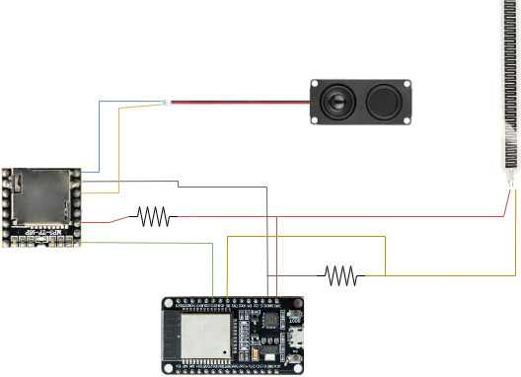
Hardware components
ESP32
Pressure Sensor
MP3 TF-ID
Speaker

Slide 4

Software implementation
The software was implemented using the Arduino IDE.
Several libraries were used:
SoftwareSerial.h
DFRobotDFPlayerMini.h
Wifi.h
PubSubClient.h
HTTPClient.h

Slide 5
Threshold configuration
Threshold can give rise to many false positives.
A simple threshold selection pipeline was followed:
Put the pressure sensor under the bed.
Check the value in an idle state.
Check the value with a person on it.
Decide a reasonable value between the two boundaries.

Slide 6

Data proxy server
Core component of the application, manages both the user and device interactions all via HTTP requests.
User list of commands:
set_time
set_sleeping_hours
set_threshold
set_days
sampling_rate
stop_alarm
show_variables
ESP32 list of commands:
alarm_stopped
data
time

Slide 7


Data proxy server - MQTT
Interactions with ESP32 is bidirectional, the server uses an MQTT broker to send data to the device.
ESP32 subscribed topics:
esp32/commands/stop_alarm
esp32/commands/trigger_alarm
esp32/commands/sampling_rate

Slide 8


Data proxy server - InfluxDB
Also handles tranmission of device data to the time-series database.
After the time command is received.

Slide 9

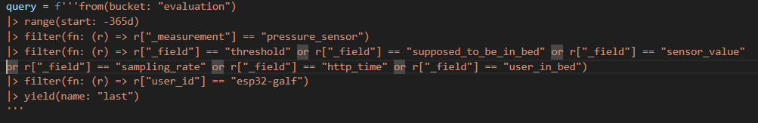
Data analysis module
Takes as input four parameters:
start_date
start_time
end_date
end_time
Computes sleep time and mean latency between those dates

Slide 10

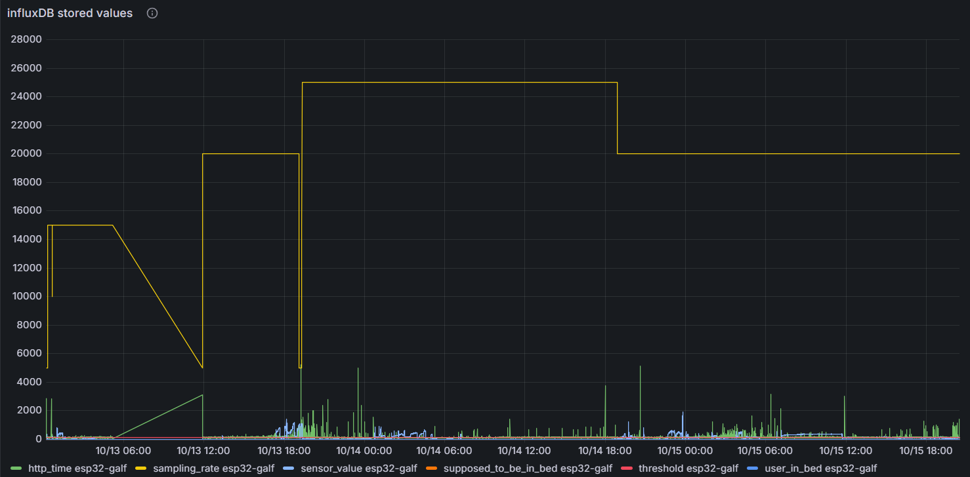
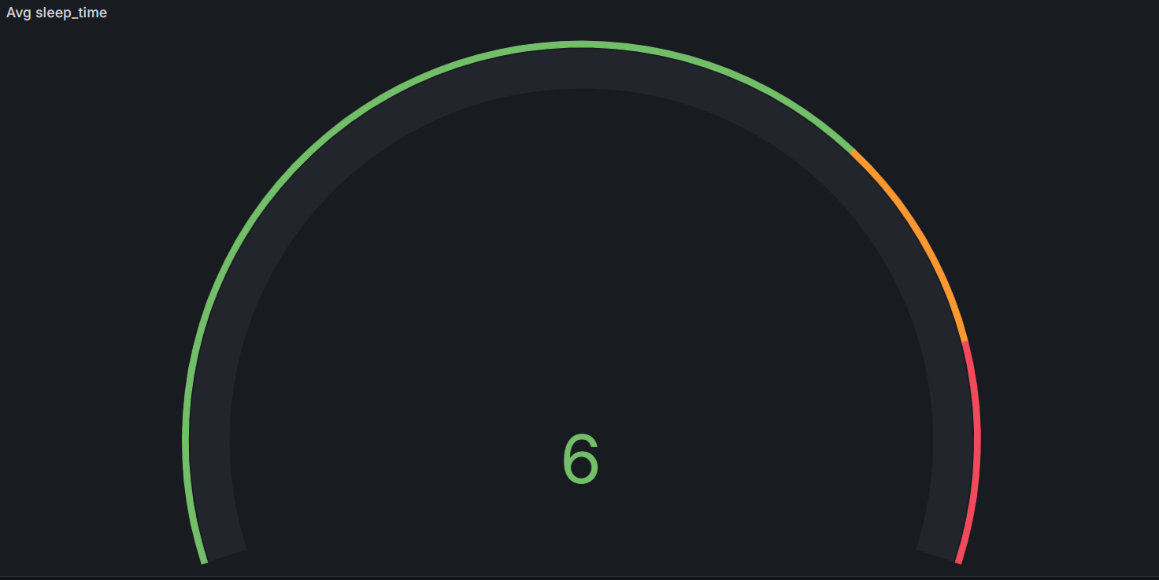
Grafana Dashboard
Used to display metrics and the average sleeping time

Slide 11
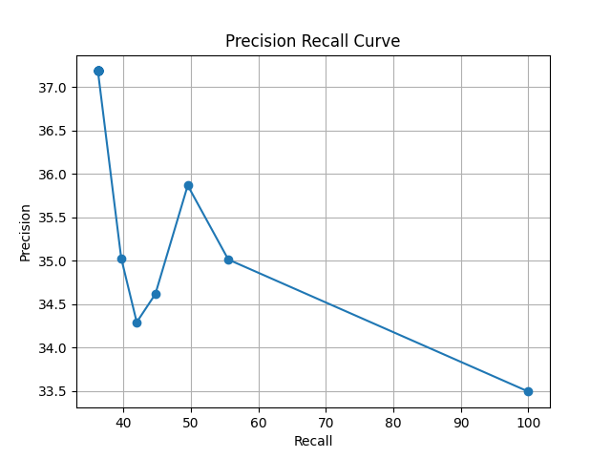
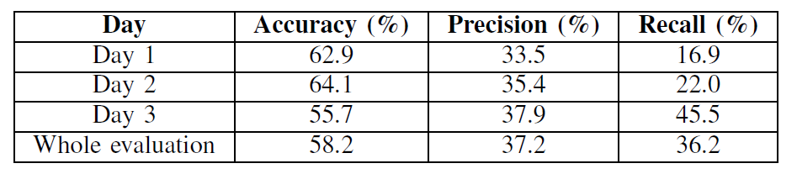
Data evaluation module
Used to compute accuracy, precision, recall as well as precision-recall curves.

Slide 12

Thanks for the attention!

